Slide 1

Methodology - Image Classification
1
Classification of tomatometer status based on movie poster
2
Feature : Various movie posters (Augmentation)
3
Target: Binary Categorical (Fresh & Rotten)
4
Model chosen : CNN, Transfer Learning, Class Activation Map

Slide 2
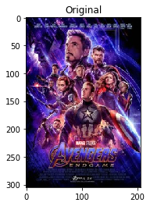
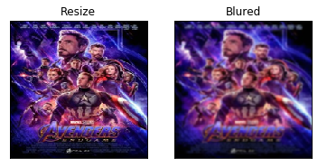
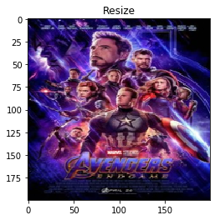
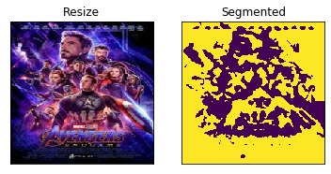
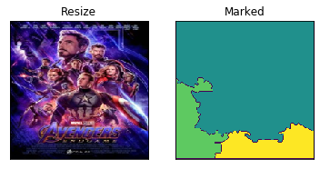
Result & Analysis - Image Pre-processing
16.6K valid poster images
each of size (305, 206, 3) → color image
Preprocessing & Exploration:
Resizing: (224, 224, 3);
Denoise: Blurred image;
Segments: separate background from foreground;
Marked: label different objects from image;
Transform all images to numpy arrays for further deep learning:
X → (16,000, 224, 224, 3)
y → binary label “fresh/rotten” (encoder 1/0)
Train size → 7,680; Validate size → 5,120
Test size → 3,200.
13

Slide 3
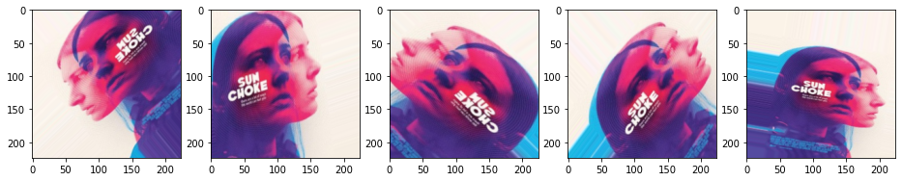
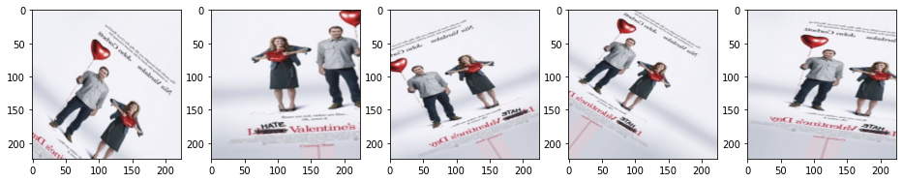
Result & Analysis - Image Augmentation
Argumentation of poster from Fresh class:
Artificially creates training images through random :
rotation,
shifting,
shearing,
flipping
zooming, etc. (some examples)
Purpose of image augmentation:
Expand the size of training dataset → Solve imbalanced classes issue;
Ability of the model to generalize → Prevent overfitting;
Implementation using:
Keras deep learning library via the ImageDataGenerator class.
Argumentation of poster from Rotten class:
13

Slide 4
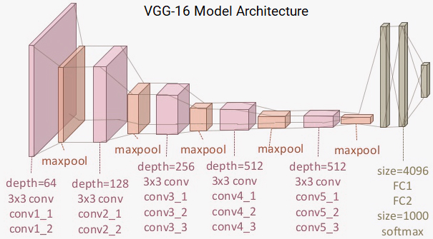
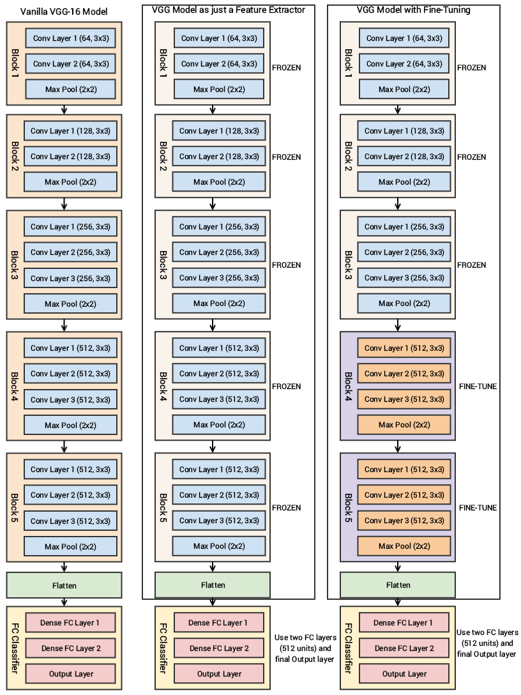
Result & Analysis - Transfer Learning
Feature Extraction
Fine Tuning
Pre-trained models:
VGG-16, InceptionsResNetV2, InceptionV3, etc.;
deep networks trained on huge datasets (1.2M images with 1000 classes) for large-scale visual recognition;
Advantages of Transfer Learning:
Able to utilize the knowledge from previous trained deep networks:
not enough train data
faster training speed: can achieve high accuracy only with less training steps (epochs)
Limitations of Transfer Learning:
performs well if features are general
suitable for both base and target tasks
not suitable if too specific to base task
VGG-16:
13 convolution layers
5 convolution blocks;
2 fully connected hidden layers;
output dense layer (1000 classes);
remove last 3 layers;
Used as:
feature extraction (fix all weights)
fine tuning (unfreeze last two blocks)
13

Slide 5
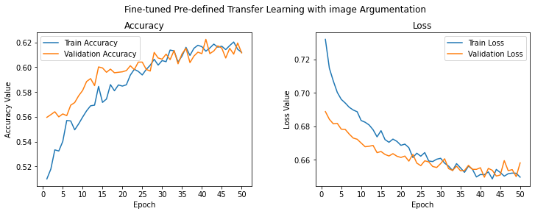
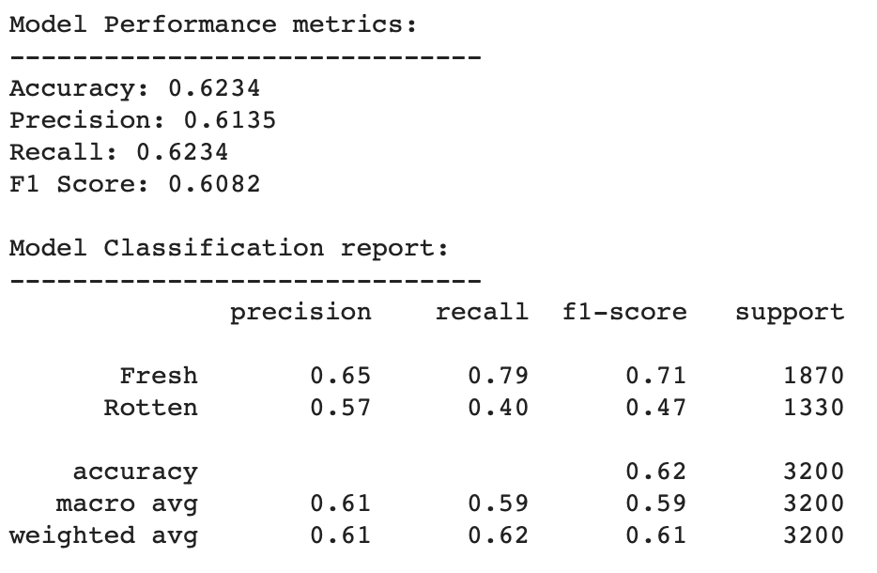
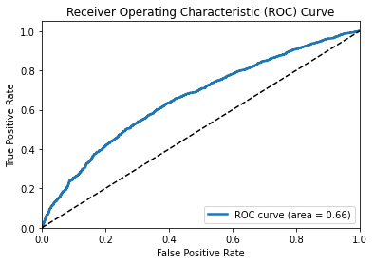
Result & Analysis - CNN with Transfer Learning
Models | Training accuracy | Validation accuracy
Basic CNN | 0.99 | 0.55
CNN with Regularization | 0.75 | 0.56
Regularized CNN with Image Argumentation | 0.59 | 0.58
Transfer Learning VGG16 (Feature Extractor) | 0.62 | 0.61
Transfer Learning VGG16 (Feature Extractor) with Argumentation | 0.62 | 0.61
Transfer Learning VGG16 with Fine-Tuning and Argumentation | 0.62 | 0.62
Transfer Learning InceptionResNetV2 with Fine-Tuning and Argumentation | 0.66 | 0.62
Transfer Learning InceptionV3 with Fine-Tuning and Argumentation | 0.64 | 0.61
13
Notes:
VGG - Visual Geometry Group

Slide 6

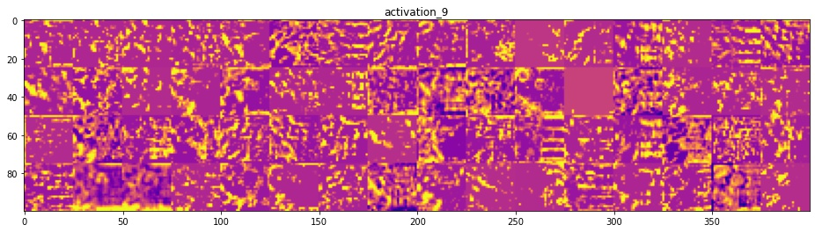
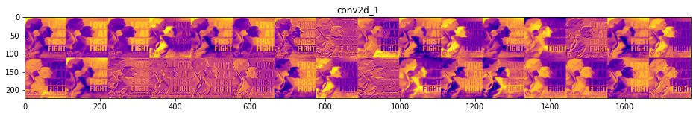
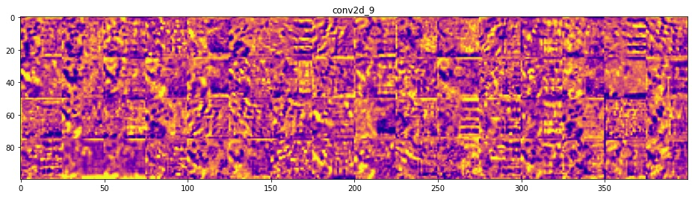
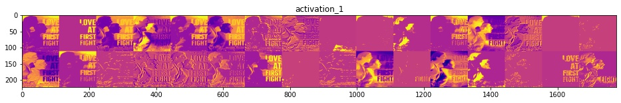
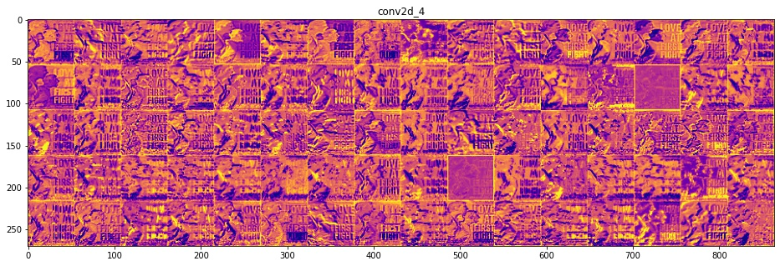
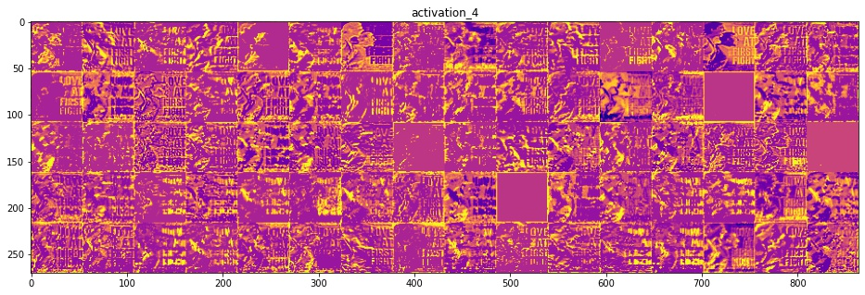
Result & Analysis - Visualize the Intermediate Layers
13
15

Slide 7


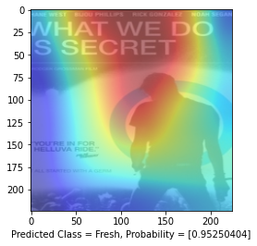
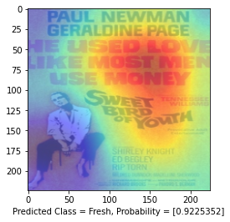
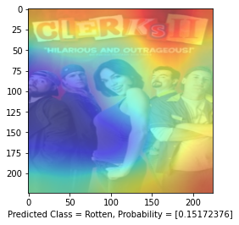
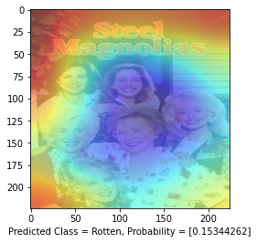
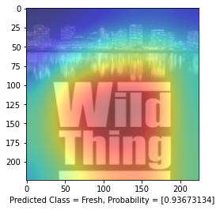
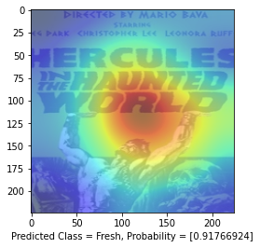
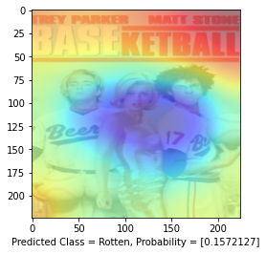
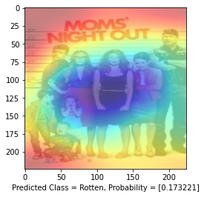
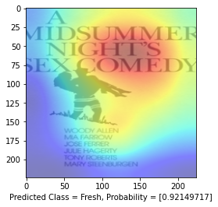
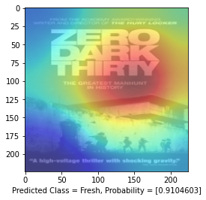
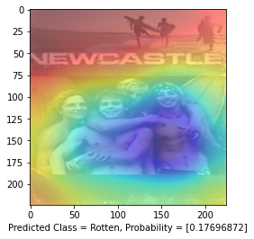
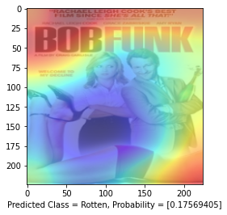
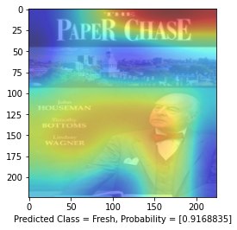
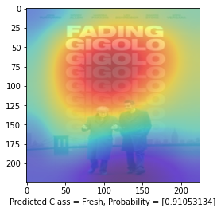
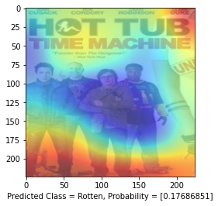
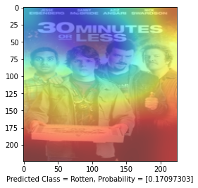
Result & Analysis - Class Activation Maps
Predicted
Top 8 Fresh
Predicted
Top 8 Rotten
A class activation map for a particular category indicates the discriminative region used by CNN to identify the category;
Visualize the weights projected back from outputs using heatmap, indicating how important each input region is with respect to the output category;
Fresh → Big font of Movie Titles with less characters(for certain genre: drama)
Rotten → Group of characters stacking occupies most part of the poster (comedies)
Limitation and Thoughts:
Title Dominanant;
Movie genre;
Other factors affecting the audience response.
13
16
Notes:
The idea behind is to compute the gradient of the output category with respect to the input image. This should tell us how the output value changes with respect to a small change in the input. We can use these gradients to highlight input regions that cause the most change in the input. Intuitively, this should highlight the image regions that contribute most to the output.

